Slide 1
CPSC 583 Expert Systems Design Theory
Dr. Anand Panangadan
apanangadan@fullerton.edu

Slide 2
Knowledge engineering
Special-purpose knowledge bases
Electronic circuits
Actions (Situation Calculus)
General-purpose knowledge bases
Represent classes of objects and relationships between classes
Events
Time
Semantic Web
AI: A modern approach Ch. 10-10.3, 10.5
Some slides adapted from Structured Knowledge Representation by Dave Touretzky
Franz Kurfess, Cal Poly SLO

Slide 3
Knowledge representation
Expert Systems = Facts + Inference
How to represent facts?
Ontological Engineering
An attempt to formalize human knowledge to be computationally useful
A prerequisite for Artificial General Intelligence (AGI).
Ontology
An organization of objects and concepts

Slide 4
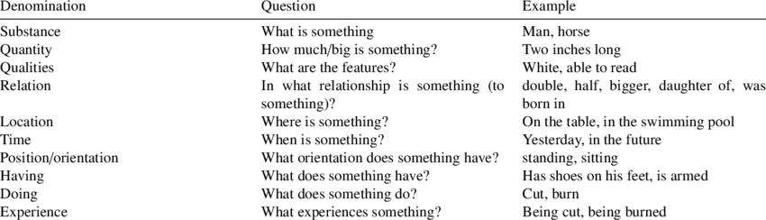
Knowledge representation
Isn’t this philosophy?
Yes, the problem dates back to Aristotle.
But philosophers don’t have to test their theories by writing code that works.
Isn’t this cognitive science?
Cognitive science has made important contributions, e.g., examining how human category learning works.
But AI has a different focus: it requires implementable algorithms.

Slide 5
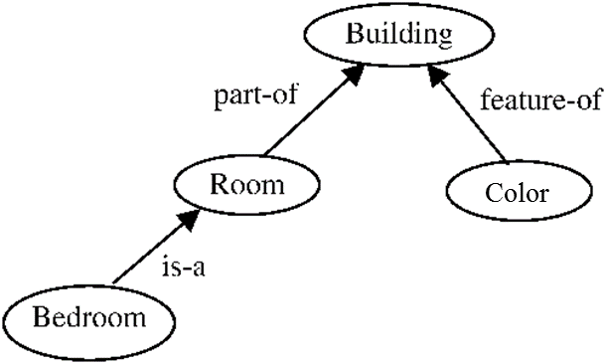
Ontology
Formally representing knowledge as a hierarchy of concepts within a domain, using a shared vocabulary to denote the types, properties and interrelationships of those concepts.
Notes:
Introduce the semantic web
Ontology – representation of the semantic web
Examples: Is-a: type; part-of: interrelationship; feature: property
We consider both schema and content in our work

Slide 6
Some terminology
Vocabulary/lexicon
A set of terms that a community decides to share and reuse
Ontology
Relationships between the terms in a vocabulary
Upper Ontologies define basic, abstract concepts
Lower Ontologies define domain-specific concepts
Taxonomy
Arrangement of vocabulary terms into a hierarchy
Taxonomy can be the “backbone” of a more complex ontology
Thesaurus
Relationships between words
Synonyms, Antonyms, Homonyms, …
Often combined with a taxonomy
A knowledgebase contains both schema (class and property definition) and content (“individuals”)
Notes:
Introduce the semantic web
Ontology – representation of the semantic web
Examples: Is-a: type; part-of: interrelationship; feature: property
We consider both schema and content in our work

Slide 7
Ontology in Information Science
An ontology is an engineering artefact consisting of:
A vocabulary used to describe (a particular view of) some domain
An explicit specification of the intended meaning of the vocabulary.
Often includes classification-based information
Constraints capturing background knowledge about the domain
Ideally, an ontology should:
Capture a shared understanding of a domain of interest
Provide a formal and machine manipulatable model
Notes:
In Information Science, an ontology is the product of an attempt to formulate an exhaustive and rigorous conceptual schema about a domain. This domain does not have to be the complete knowledge of that topic, but purely a domain of interest decided upon by the creator of the ontology.
An ontology is typically a hierarchical data structure containing all the relevant entities and their relationships and rules within that domain (e.g., a domain ontology). However, computational ontology does not have to be hierarchical at all. The computer science usage of the term ontology is derived from the much older usage of the term ontology in philosophy.
An ontology which is not tied to a particular problem domain but attempts to describe general entities is known as a foundation ontology or upper ontology. Typically, more specialized domain specific schemata must be created to make the data useful for real world decisions.

Slide 8
General purpose vs. special purpose ontologies
General purpose:
Special purpose:
applicable to several domains
with the addition of domain-specific axioms
DBPedia
Google’s Knowledge Graph
Cyc
applicable to one domain
Tree of life
SNOMED
Professional Petroleum Data Model (PPDM)
Domain-specific knowledge
General knowledge
Logic
IBM Watson
Game playing
Autonomous driving
Machine translation
Robot walking
Image understanding

Slide 9
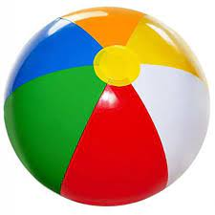
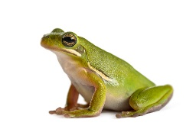

Objects vs. Categories
Interaction is with individual objects
But reasoning is with categories
Can be used to play soccer?
Can a be a pet?
is a Ball; soccer is played with a Ball => Yes!
is a Beachball; soccer is played with a Ball => No!
is an Animal; Animal => can be a pet => Yes!
is a WildAnimal; DomesticatedAnimal => can be a pet => No!

Slide 10
Relationship between Objects and Categories
instance-Of relationship
Japan instance-Of Country.
CPSC131 instance-Of Class.
…
rdf:type in Semantic Web

Slide 11
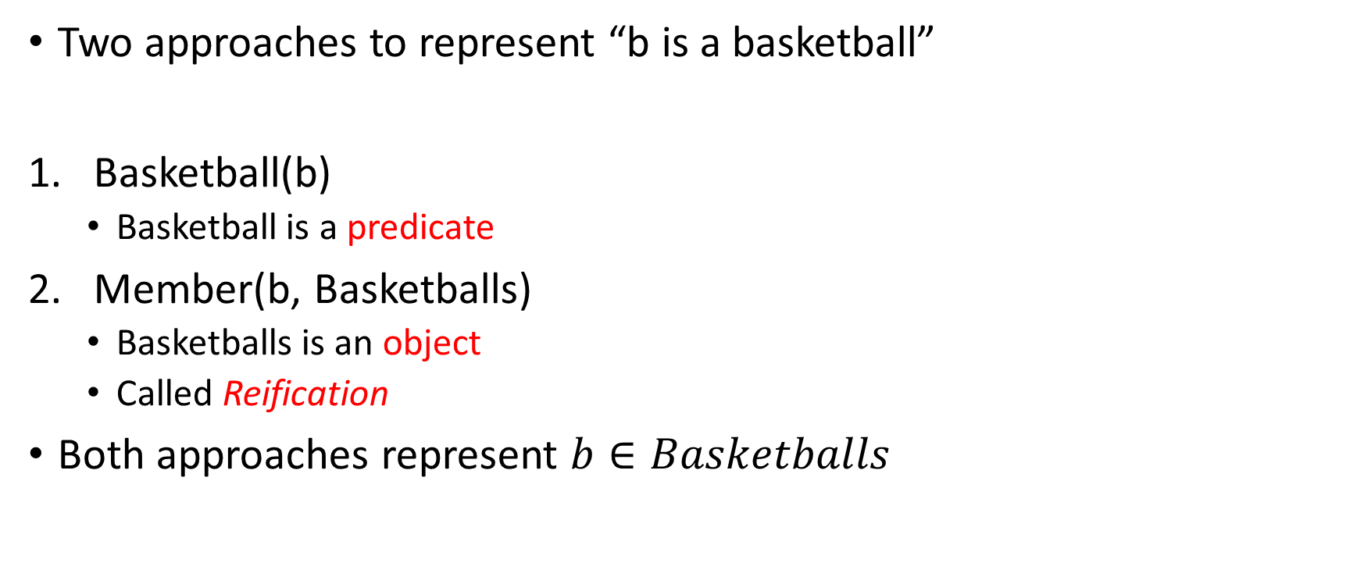
Representing Categories in FOL
Two approaches to represent “b is a basketball”
Basketball(b)
Basketball is a predicate
Member(b, Basketballs)
Basketballs is an object
Called Reification
Both approaches represent $b∈Basketballs$

Slide 12
Relationships between Categories
Subcategory/Subset
Subset(Mammals, Vertebrates)
The most important relationship
IS-A relationship
Inheritance:
All members of the subclass inherit properties of the superclass
Taxonomy
A hierarchy of subclass relations
E.g., Tree of life

Slide 13
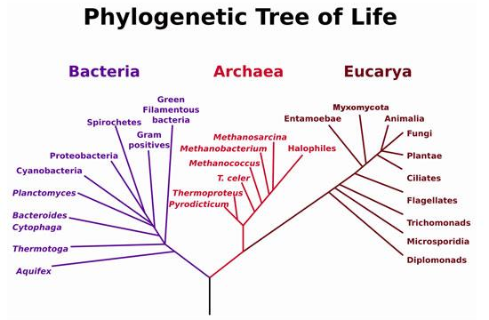
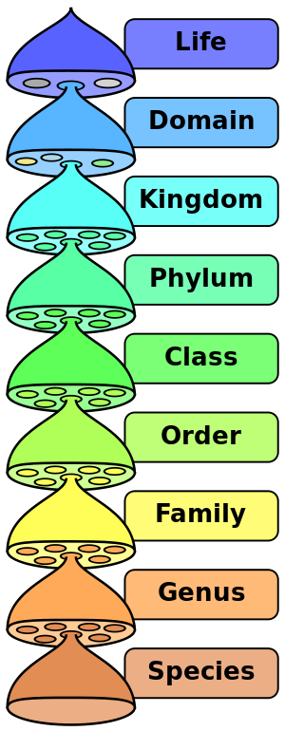
Taxonomic Hierarchies
10 million living and extinct species.

Slide 14
Relationships between Categories
Subcategory/Subset
Subset(Mammals, Vertebrates)
Disjoint
Disjoint ({Animals, Vegetables})
Partition
Partition ({Males, Females}, Animals)

Slide 15
Ontology: what are the different kinds of stuff?
Natural kinds: cats, flowers, rocks, comets, tornadoes
Places: Pittsburgh, North America, the Starbucks on Craig Street
Organizations: companies, clubs, unions, political parties
Mental phenomena: thoughts, emotions, memories, beliefs, instincts
Linguistic phenomena: languages, dialects, words, phrases, idioms
Mathematical objects: numbers, functions, relations, theorems, axioms
Political/economic philosophies: capitalism, communism, socialism, Marxism
Physiological phenomena: digestion, respiration, reproduction, sleep
Games: checkers, chess, backgammon, go, poker, bridge, solitaire
Kinship relations: parent, grandparent, sibling, aunt, uncle, cousin, spouse
Tools: hammer, screwdriver, wrench, saw, file, crowbar, MATLAB
Food: pizza, pad thai, souvlaki, lo mein, duck a l’orange

Slide 16
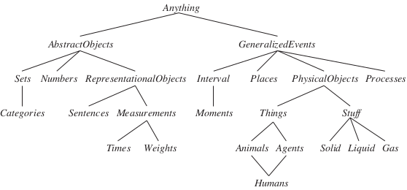
An “upper ontology” of the world

Slide 17
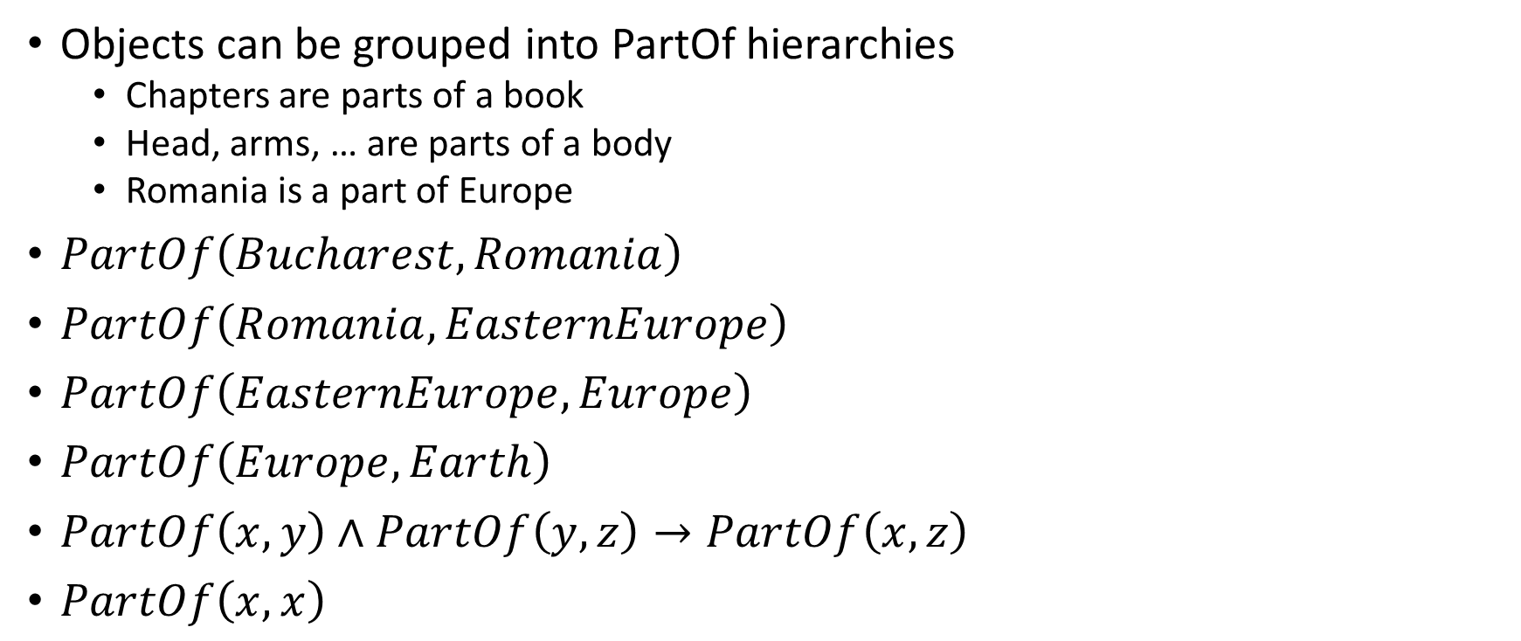
Part-of hierarchies
Objects can be grouped into PartOf hierarchies
Chapters are parts of a book
Head, arms, … are parts of a body
Romania is a part of Europe
$PartOf\left(Bucharest, Romania\right)$
$PartOf\left(Romania, EasternEurope\right)$
$PartOf\left(EasternEurope, Europe\right)$
$PartOf\left(Europe, Earth\right)$
$PartOf\left(x, y\right)∧PartOf\left(y, z\right)→PartOf\left(x, z\right)$
$PartOf\left(x, x\right)$

Slide 18
Part-Of hierarchies
Human body
Limbs
Arm IS-A Limb
Forearm
Elbow IS-A Joint
Hand
Finger
Knuckle IS-A Joint
Fingernail
Limb IS-A BodyPart
Bones
Muscles
Joints
Skin
An arm has bones because arms are limbs and limbs have bones.
The bones of the hand are bones of the arm because hands are parts of arms.

Slide 19
Classwork: Which of these are a PartOf relation?
Alice’s heart is part of Alice’s body
Swallowing is part of eating
Clay is part of a vase
Orange county is part of California

Slide 20
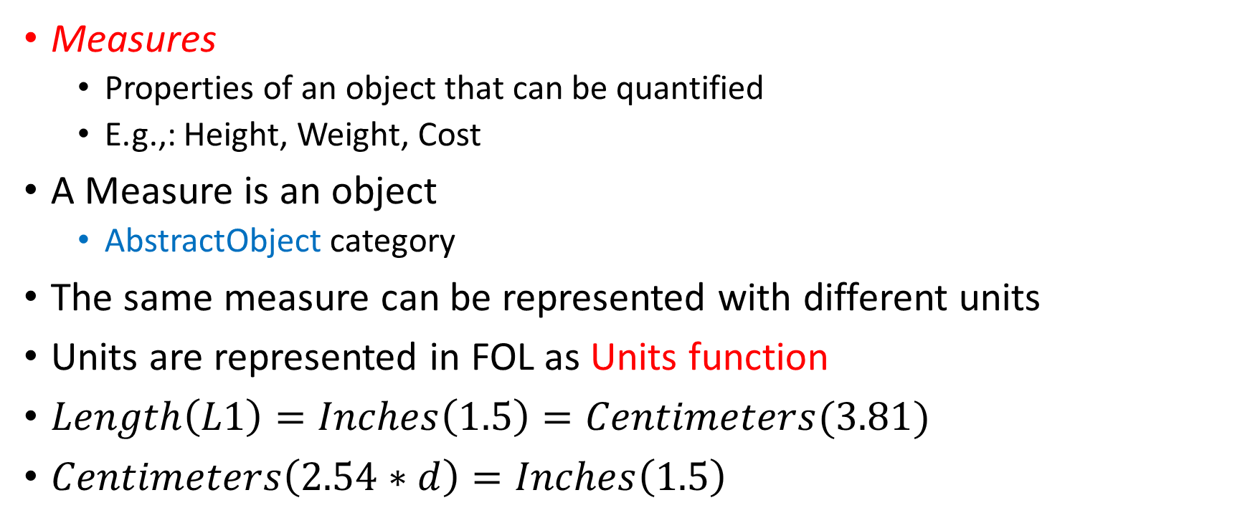
Measurements
Measures
Properties of an object that can be quantified
E.g.,: Height, Weight, Cost
A Measure is an object
AbstractObject category
The same measure can be represented with different units
Units are represented in FOL as Units function
$Length\left(L1\right)=Inches\left(1.5\right)=Centimeters(3.81)$
$Centimeters\left(2.54∗d\right)=Inches\left(1.5\right)$

Slide 21

Measurements
Can also reason over qualitative measurements
E.g., beauty, difficulty, delicious
$Difficulty\left(CPSC131\right)>Difficulty(CPSC121)$

Slide 22
Things vs. Stuff
“Things” are discrete objects composed of distinct parts
Countable nouns
“Stuff” are objects that can be divided into smaller amounts of the same stuff
Mass nouns
Example: “butter”
Intrinsic (definitional) properties: color, taste, density, melting point
Extrinsic properties: weight, shape, location
Stuff: are defined with only intrinsic properties
Things: are defined with both intrinsic and extrinsic properties

Slide 23
Representing time
How to reason about
Actions that take place over an extended period of time?
E.g., getCollegeDegree
Actions that take happen simultaneously/overlap/before another?
E.g., take CPSC131 before CPSC121

Slide 24
Time and events
Classical planning uses situational calculus, where events are discrete, instantaneous, and happen one at a time.
We need something more powerful if we want to model continuous processes or concurrency.
The event calculus provides tools for this.
Reify fluents and events, turning them into objects.
Define intervals as continuous segments of time with a start and end time
i = (t₁,t₂)
Begin(i) = t₁, End(i) = t₂
Use predicates such as Happens(e, t₁,t₂) to indicate the interval in which an event happens.

Slide 25
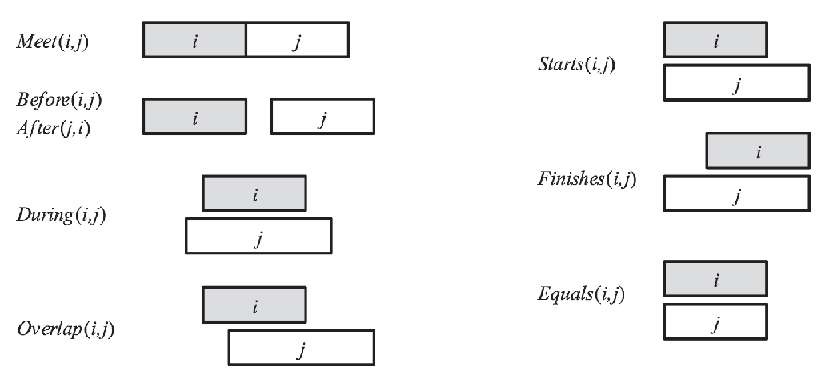
Relationships between intervals

Slide 26

Relationships between intervals
$Meets(ReignOf\left(ElizabethII\right), ReignOf(CharlesIII)$
$Overlap(Fifties, ReignOf(Elvis)$
$Begin\left(Fifties\right)=Begin(AD1950)$
$End\left(Fifties\right)=End(AD1959)$

Slide 27
Class work
Write the interval relation that holds between every pair of the following real-world events
LK: The life of President Kennedy
IK: The infancy of President Kennedy
PK: The presidency of President Kennedy
LJ: The life of President Johnson
PJ: The presidency of President Johnson
LO: The life of President Obama

Slide 28
Predicates for event calculus
Happens(e, t1, t2) Event e starts at t1 and ends at t2
T(f, t1, t2) Fluent f is true at time t1 <t<t2
Initiates(e, f, t) Event e causes fluent f to start to hold at time t.
Terminates(e, f, t) Event e causes fluent f to cease to hold at time t.
Terminated(f, t1, t2) Fluent f ceases to be true at some point between t1 and t2
Initiated(f, t1, t2) Fluent f becomes true sometime between t1 and t2.

Slide 29
How to represent ontologies?
Semantic Nets
Description Logics
Both logic-based

Slide 30
Semantic Nets
graphical representation of information
originally developed as a model for human memory
labeled, directed graph
nodes represent objects, concepts, or situations
labels indicate the name
nodes can be instances (individual objects) or classes (generic nodes)
links represent relationships
the relationships contain the structural information of the knowledge to be represented
the label indicates the type of the relationship
relationships express structure in the collection of facts
allows the generation of meaningful new knowledge
generation of new facts
generation of new relationships

Slide 31
Types of Relationships
Relationships can be arbitrarily defined by the knowledge engineer
But for reasoning, the inference mechanism must know how relationships can be used to generate new knowledge
inference methods may have to be specified for every relationship
Frequently used relationships
IS-A, MemberOf
relates an instance (individual node) to a class (generic node)
AKO (a-kind-of), SubsetOf
relates one class (subclass) to another class (superclass)

Slide 32
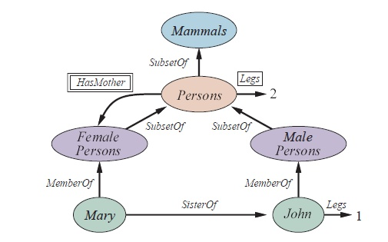
Example

Slide 33
Reasoning with default information
Objects inherit attributes of their categories
Subcategories refine attributes of their categories

Slide 34
Classwork: Reasoning with default information
Is Mary a female person?
Is John a female person?
Is John a mammal?
How many legs does John have?
How many legs does Mary have?

Slide 35
Reasoning with default information
MemberOf(Mary, FemalePersons)
SisterOf(Mary, John)
Legs(John, 2)
….
Family(Mary, John, Peter)?

Slide 36
Implementation
Tables
Simple and efficient representation schemes for semantic nets
tables that list all objects and their properties
tables for relationships
Predicate logic
nodes correspond to variables or constants
links correspond to predicates

Slide 37
Table-based implementation
object-attribute-value triples
can be used to characterize the knowledge in a semantic net
quickly leads to huge tables
Object | Attribute | Value
Astérix | profession | warrior
Obélix | size | extra large
Idéfix | size | petite
Panoramix | wisdom | infinite

Slide 38
Problems with Semantic Nets
expressiveness
no internal structure of nodes
relationships between multiple nodes
no easy way to represent heuristic information
extensions are possible, but cumbersome
best suited for binary relationships
efficiency
may result in large sets of nodes and links
search may lead to combinatorial explosion
especially for queries with negative results
usability
lack of standards for link types
naming of nodes
classes, instances
© Franz J. Kurfess

Slide 39
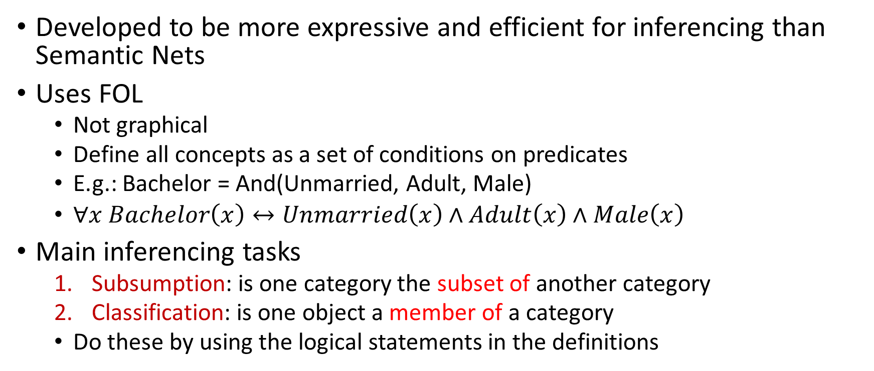
Description Logics
Developed to be more expressive and efficient for inferencing than Semantic Nets
Uses FOL
Not graphical
Define all concepts as a set of conditions on predicates
E.g.: Bachelor = And(Unmarried, Adult, Male)
$∀x Bachelor\left(x\right)↔Unmarried\left(x\right)∧Adult\left(x\right)∧Male\left(x\right)$
Main inferencing tasks
Subsumption: is one category the subset of another category
Classification: is one object a member of a category
Do these by using the logical statements in the definitions

